Slide 1
Building network models for Alzheimer’s Disease pathology
Ian Brettell
CSIRO summer vacation project 2017/18
Supervisor: James doecke

Slide 2
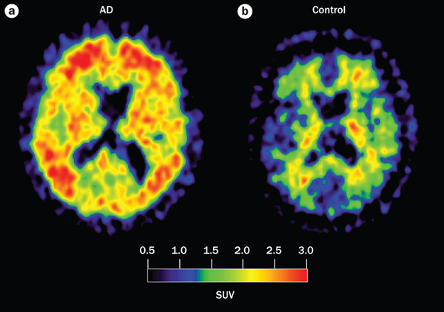
Alzheimer’s Disease
Neurodegenerative disorder:
Symptoms: memory loss, disorientation, problems with language, and mood swings
Almost always late onset ( > 65 years)
Costs in the US alone: ~$200 billion per year
Caused by build-up in the brain of misfolded amyloid-beta protein (Aβ)
neurotoxic
Nordberg et al. (2010) The use of PET in Alzheimer disease

Slide 3
What causes the build-up of Aβ?
Genetics are implicated (estimated 50 – 70% heritability)
Major risk factor: APOE-ε4 allele
40 – 80% of people have at least one copy
Many other genes contribute to risk
But how?
functional proteins
amyloid-like fibrils
Chiti and Dobson (2006) Protein misfolding, functional amyloid and human disease

Slide 4
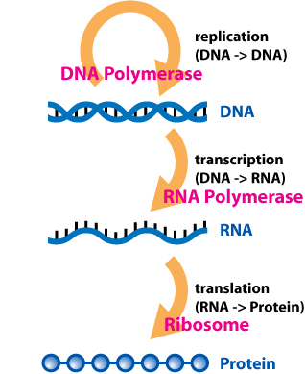
Central dogma of molecular biochemistry
https://en.wikipedia.org/wiki/Central_dogma_of_molecular_biology

Slide 5
Example of the effect of mutations (1)
ATGCTTTAGTCGTAAAAAATTAA
(healthy)
DNA
ATGCTTTAGTCGTCAAAAATTAA
(diseased)
SNP
mRNA
AUGCUUUAGUCGUCAAAAAUUAA
X

Slide 6
Example of the effect of mutations (2)
TTAGGTTTCTCGTCTTACCCGAAA
(creates stronger repressor)
ATGCTTTAGTCGTAAAAAATTAA
ATGCTTTAGTCGTAAAAAATTAA
healthy
disease

Slide 7
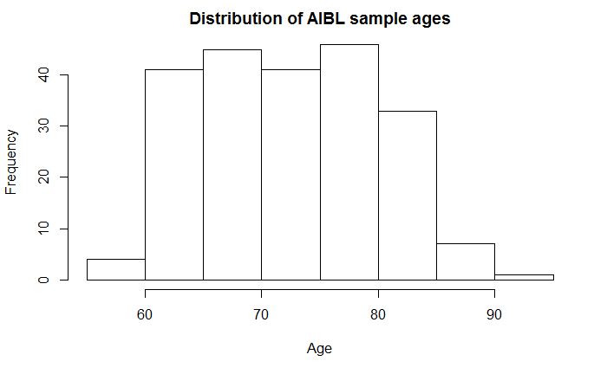
Sample and data
Sample taken from the AIBL study (Australian Imaging, Biomarkers & Lifestyle flagship study of ageing)
For 193 individuals, we have the following data:
Aβ-pos or –neg status from PET scans
Genotypes (e.g. A/A or A/T) for ~2,000 SNPs associated with AD
Gene expression levels for ~22,000 genes (from blood samples)
Question: what are the relationships between the genotypes and gene expression patterns that might contribute to the development of AD?

Slide 8
Stages of analysis
Stage 1: Analysis of expression data
Stage 2: Analysis of genotype data
Stage 3: Network analysis

Slide 9
Stage 1: Expression data
Which genes are differentially expressed between the Aβ-pos and –neg groups?
healthy
disease
?
?

Slide 10
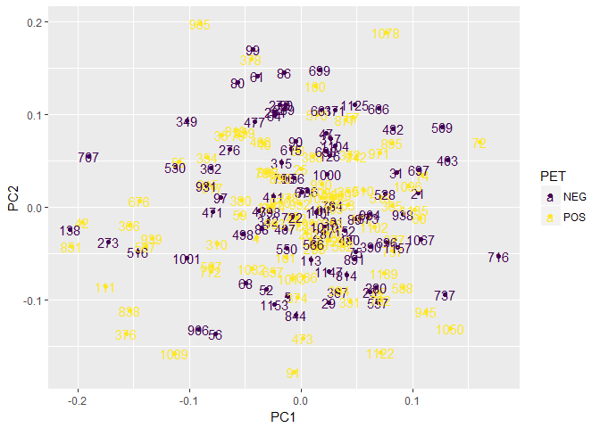
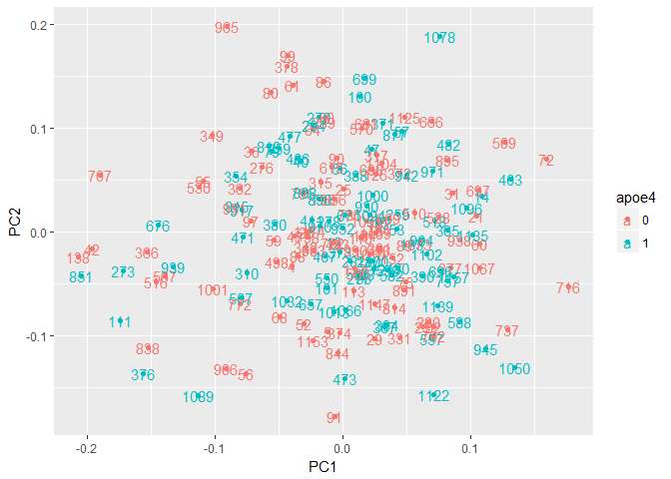
Stage 1: expression data

Slide 11
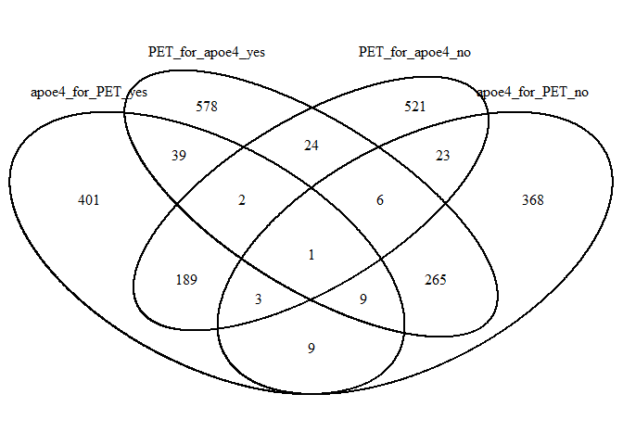
Stage 1: expression data
Comparison between Aβ-pos and –neg groups
 | Count
No. differentially expressed probes | 865
No. of those probes we could annotate with the a gene name | 530
Further analysis
Cause AD independent of APOE-ε4?
Protect against the effect of APOE- ε4?

Slide 12
Stage 2: genotype data
Association analyses between allele and Aβ-pos or –neg status
 | No. significant SNPs (p < 0.05) | No. genes mapped to the significant SNPs
Association | 72 | 58
Logistic regression with covariates (age, sex, | 83 | 59
Intersection between the above analyses | 43 | 47
E.g. for a given SNP, do those with a T instead of an A more likely to be Aβ-pos?
Repeat for all 2,000 SNPs
None significant at the FDR-adjusted level (small sample size)

Slide 13
Stage 2: genotype data
eQTL analyses
 | No. significant SNPs (q < 0.05 FDR-adjusted | No. differentially expressed genes | No. of SNPs acting in cis
Total cohort | 130 SNPs mapped to 101 genes | 2,242 | 8
Aβ-pos only | 28 SNPS mapped to 31 genes | 48 | 0
Aβ-neg only | 35 SNPs mapped to 34 genes | 74 | 0
E.g. for a given SNP, do those with a T instead of an A express more of a given gene?
Repeat for all ~2,000 SNPs with all ~22,000 genes

Slide 14
Stage 3: network analysis
Comparison between Aβ-pos and –neg groups
 | Count
No. differentially expressed probes | 865
No. of those probes we could annotate with the a gene name | 530
249 networks
(containing 5073 unique genes)
Remove genes we don’t have expression data for

Slide 15
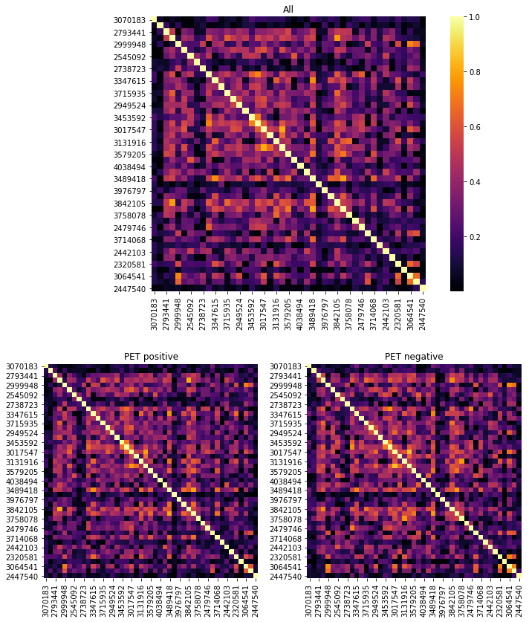
“Enriched Network Decomposition” (END)
A: filter for differentially-correlated genes
For each network, separate the Aβ-pos and –neg groups
Calculate the correlations between each pair of genes for both groups
Compare how the correlation patterns differ, and pull out the genes that differ the most

Slide 16
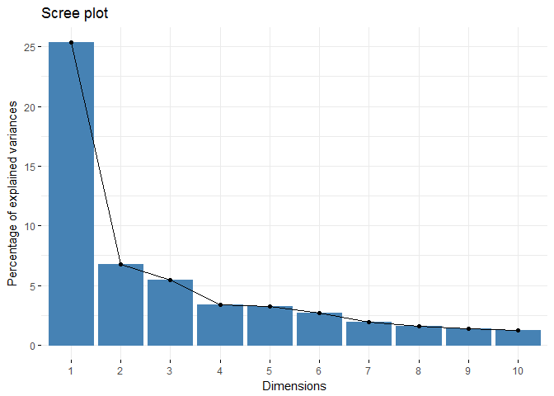
Stage 3: network analysis
END
B: Create eigenvalues
For each network containing just the genes that were the most differentially correlated between Aβ-pos and –neg groups, we take the first eigenvalue
Explains the most variance in expression levels
Repeat for all 249 networks

Slide 17
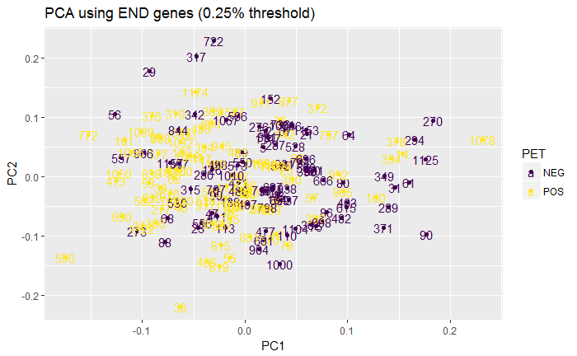
Stage 3: network analysis
END
C: Run PCA on eigenvalues

Slide 18
Next steps
Build a model that can more reliably predict Aβ status using:
END values, plus
Genotype data
Validate model using data from brain tissue from different cohort (US)
Consistent patterns between what we’ve found in blood in the AIBL cohort, and what we find in the brain in the US cohort might shed light on disease pathology.
Biomarker for diagnosis
Potential drug targets

Slide 19
Questions?

